Slide 1
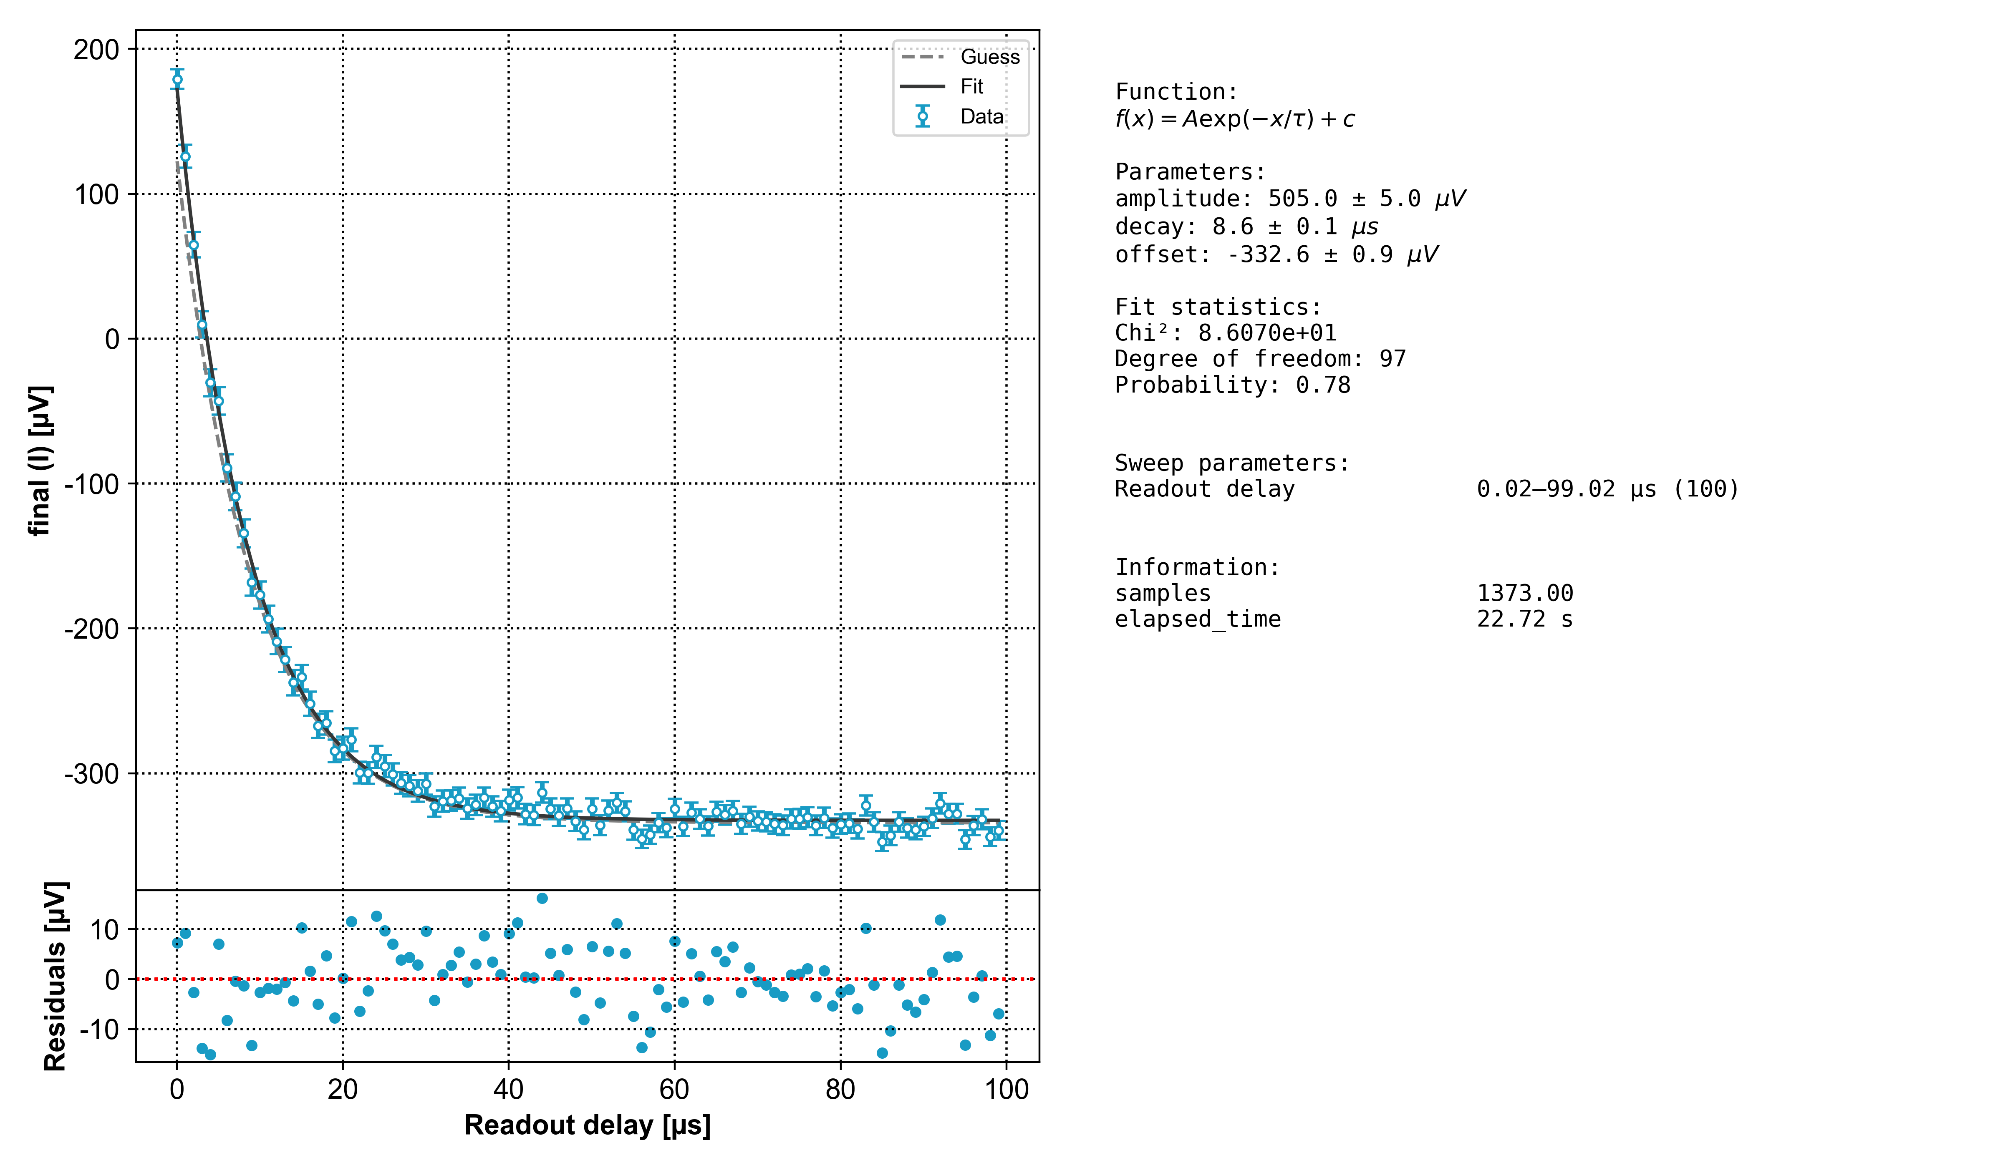

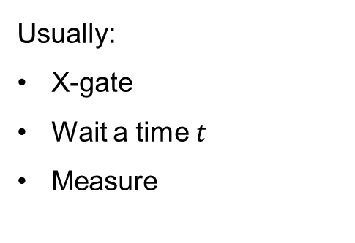
Group Meeting Update 16/8-2023
In measurement $T_{1}$- calibration
Usually:
X-gate
Wait a time $t$
Measure
Alternatively?
X-gate
Measure *

Slide 2
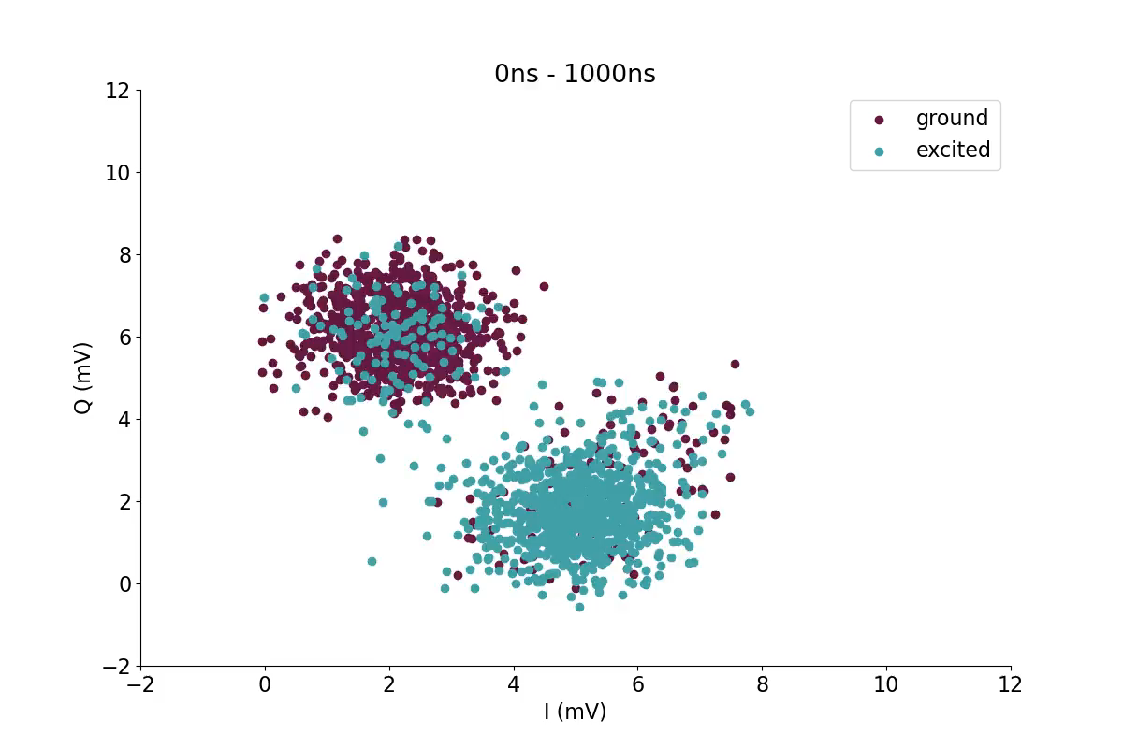
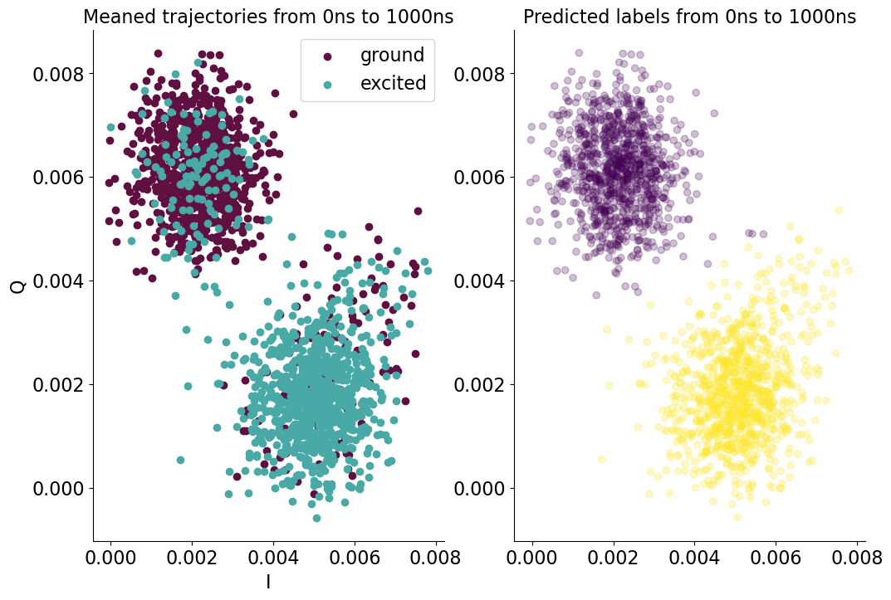
Group Meeting Update 16/8-2023
In measurement $T_{1}$- calibration

Slide 3
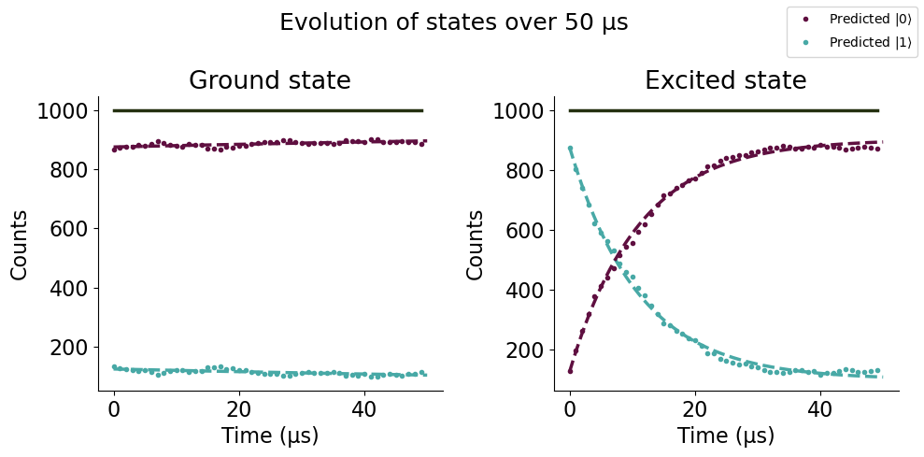
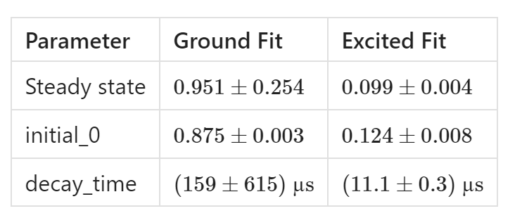
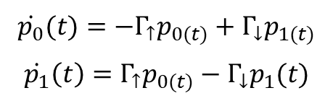
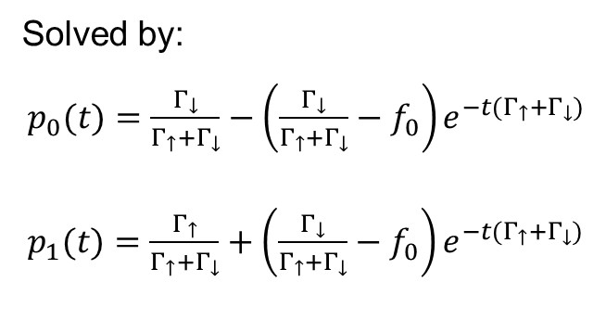
Group Meeting Update 16/8-2023
In measurement $T_{1}$- calibration
Two states evolving:
​\dot{p_{0}}(t)=−\Gamma_{\uparrow}p_{0(t)}+\Gamma_{\downarrow}p_{1(t)}𝑝0(𝑡)=−Γ↑𝑝0(𝑡)+Γ↓𝑝1(𝑡)​
​\dot{p_{1}}(t)=\Gamma_{\uparrow}p_{0(t)}−\Gamma_{\downarrow}p_1(t)𝑝1𝑡=Γ↑𝑝0(𝑡)−Γ↓𝑝1(𝑡)​
Solved by:
​p_{0}(t)=\frac{\Gamma_\downarrow}{\Gamma_\uparrow+\Gamma_\downarrow}−\left(\frac{\Gamma_\downarrow}{\Gamma_\uparrow+\Gamma_\downarrow}− f_{0}\right)e^{−t(\Gamma_\uparrow+\Gamma_\downarrow)}𝑝0(𝑡)=Γ↓Γ↑+Γ↓−Γ↓Γ↑+Γ↓−𝑓0𝑒−𝑡(Γ↑+Γ↓)​
​p_{1}(t)=\frac{\Gamma_\uparrow}{\Gamma_\uparrow+\Gamma_\downarrow}+\left(\frac{\Gamma_\downarrow}{\Gamma_\uparrow+\Gamma_\downarrow}− f_{0}\right)e^{−t(\Gamma_\uparrow+\Gamma_\downarrow)}𝑝1(𝑡)=Γ↑Γ↑+Γ↓+Γ↓Γ↑+Γ↓−𝑓0𝑒−𝑡(Γ↑+Γ↓)​
*
* $\left(9.9±0.5\right) µs$ from usual calibration

Slide 4
Group Meeting Update 16/8-2023
In measurement $T_{1}$- calibration
Next up:
Repeat to check bias
Add active reset
Include waiting time to do both experiments at once
*
* $\left(9.9±0.5\right) µs$ from usual calibration

